Slide 1
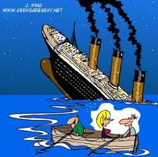
COMMON EMERGENCIES IN DETOX Paula J. Colescott MD Diplomat of the American Board of Addiction Medicine paula.colescott@providence.org

Slide 2
What is the chief cause of respiratory adverse events occurring during sedation?
Airway obstruction

Slide 3
What are the signs of Airway Obstruction?
Snoring
Movement of the upper abdomen (diaphragmatic contraction) without visible signs of the chest rising and falling as one would expect with air entering the lungs
Decreased breath sounds
Stridor—loud high pitched sounds with inspiration.
Choking

Slide 4
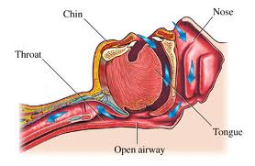

Slide 5
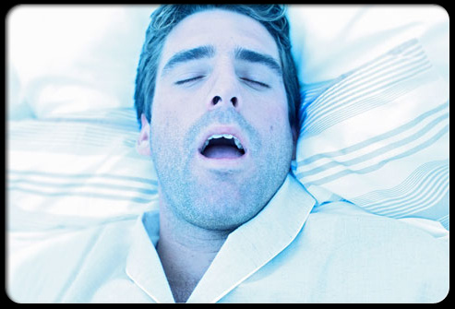
Can you predict if someone is at risk for airway obstruction if sedated?
YES
Ask if they snore
Have disturbed sleep accompanied by excessive daytime somnolence
These are hallmark symptoms of obstructive sleep apnea

Slide 6
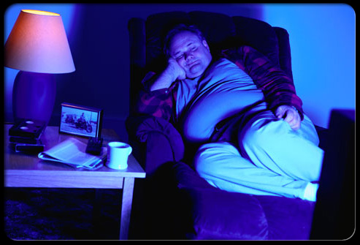
The Airway Prone to Obstruction
Notes:
Some airways are anatomically more prone to develop obstruction than others. On physical examination, these patients may have certain physical traits associated with a difficulty airway,
Obesity of the head and neck
Short distance between the mentum of the chin and thyroid cartilage (< 3 ordinary finger breadths) when the head and neck are fully extended
a small mouth opening (< 3 cm in adults
A large tongue.[16,20,
Obesity of the head and neck
Short distance between the mentum of the chin and thyroid cartilage (< 3 ordinary finger breadths) when the head and neck are fully extended
a small mouth opening (< 3 cm in adults
A large tongue.[16,20,

Slide 7
Airways with difficult mask-ventilation and tracheal intubation

Slide 8
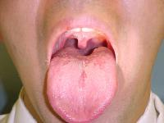
Oropharyngeal examination in a 35-year-old man reveals Mallampati grade I presentation of the palate's velum

Slide 9
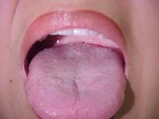
Mallampati III presentation in a 24-year-old woman. Notice how the palatal arches cannot be visualized.

Slide 10
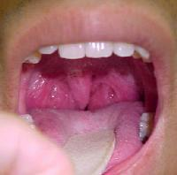

Slide 11
BZDs are Sedatives will relax muscles in a person with OSA decreased tone of the pharyngeal muscles, pharynx collapses even with small inspiration
The goal in detox is to achieve a state of Minimal sedation/anxiolysis to Moderate sedation.
The patient should be easily arousable, with ability to maintain his/her airway, with no drop in blood pressure.

Slide 12
Sedation is a continuum
Notes:
An important concept that is absolutely critical for nonanesthesiologists to understand thoroughly is the sedation continuum. The key point is that patients can move quickly between the different states or actually skip states of sedation. One major goal of the continuum is to distinguish clearly between moderate sedation and the more dangerous state of deep sedation. Further, if the patient unexpectedly enters the state of deep sedation, the clinician must be able to recognize the change and act quickly to bring the patient back to the state of moderate sedation.^{[16]}

Slide 13
Monitoring ventilatory function by observation or auscultation reduces the risk of adverse events associated with sedation

Slide 14
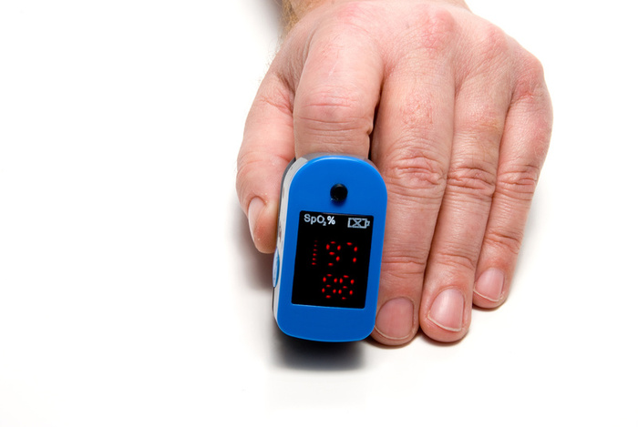
Hypoxemia : O2Sat 95% or less
. O2Sat : 90% or less significant hypoxia
requires immediate action

Slide 15
Regular monitoring of vital signs in practice also decreases the risk of adverse outcomes during moderate and deep sedation

Slide 16
Know where your emergency equipment is
Bag and mask
Suction

Slide 17
Which of the following is a main determinant of the drive to breathe in humans?
Partial pressure of CO₂ in arterial blood (PaCO₂)
Partial pressure of O₂ in arterial blood

Slide 18
Sedatives / Opioids blunt response to CO2
Notes:
increasing levels of CO₂ detected by the respiratory control center in the brainstem cause a substantial increase in minute volume in unsedated people.^{[30]} A PaCO₂ increase of just 10 mm Hg can increase the minute volume by more than 4-fold. Sedatives and opioids alter the response to CO₂ such that minute ventilation is substantially less than expected for a given PaCO₂. The "sedated curve" in this same figure shows that sedatives grossly blunt the increased minute volume responses to rising CO₂.

Slide 19
An obese 60 year old alcoholic who smokes is difficult to arouse 2 hours after 50 mg of Librium
Stimulation
Opening the airway by repositioning the head
Supplemental oxygen
Bag / Mask ventilation
Administration of reversal agents

Slide 20
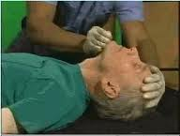
CHIN LIFT

Slide 21
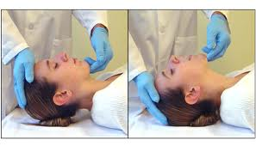
Moving the tongue forward

Slide 22
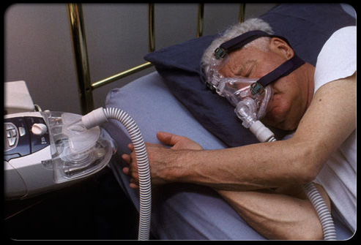
a CPAP device increases air pressure to keep airways open so you can rest more soundly without the breathing pauses that interrupt sleep.

Slide 23
BE READY
Do you know where the AED is?
Do you know where the O2 sat monitor is?
Do you know where the ambu bag is in case of a cardiac arrest?
Do you know the # for the paramedics?
Do you know how to do CPR?

Slide 24
46 year old male, alcohol dependent, day 2 withdrawal, not drinking because he is nauseated. + diarrhea. He tells you he is dizzy and weak, feels terribly anxious.
WHAT SHOULD YOU BE THINKING ??

Slide 25
DEHYDRATIION = VOLUME DEPLETION
a. Dry tongue
b. Blood pressure drops by 12-15 pt. from supine to standing
c. Pulse goes up by 15 beats/minute from supine to standing
d. Decreased urination.
e. The urine is dark (concentrated), strong smelling, and the specific gravity of the urine is > 1.020. May be + for ketones.

Slide 26
WHAT IS THE TREATMENT FOR DEHYDRATION?
1ST Treat the nausea with zofran/phenergan
2nd Give immodium to stop the volume loss from diarrhea
3nd Attempt to hydrate orally
4rd Monitor I & O s
5th check the specific gravity when the client urinates. With adequate hydration the specific gravity will decrease (1.030 1.010 )
6th if client can’t comply, send to ER for hydration
7th These efforts should be in your notes!

Slide 27
Seizures
Call for help—Code blue –get crash cart
Ease to the floor
Protect head
Maintain Airway/suction/Vitals/O2 sat/
time the seizure
Glucose finger stick, <50 give glucagon
Recovery position/support airway
Call Provider/EMS to ER
May give 1 mg Ativan per order
Complete Seizure form for ER

Slide 28
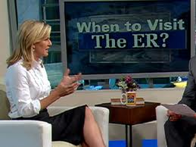

Slide 29
BE READY
Do you know where the AED is?
Do you know where the O2 sat monitor is?
Do you know where the ambu bag is in case of a cardiac arrest?
Do you know the # for the paramedics?
Do you know how to do CPR?

