Slide 1
Assessment, Diagnosis, & Pharmacologic Treatment of Alcoholism
Luther Johansen M.D.
COL, MC, USA
Consultant to Army Surgeon General on Substance Use Disorders
Notes:
I am not Luther Johansen. Luther sends his regrets from Baghdad. You’re stuck with me instead.

Slide 2
ALCOHOL USE DISORDERS
John J. Stasinos, M.D.
LTC(P), MC, USA
Chief, Chemical Addictions Treatment Services
Department of Psychiatry
Tripler Army Medical Center
Notes:
Here’s my version of Luther’s presentation.

Slide 3
Disclosures
I have no affiliation or financial relationship with any pharmaceutical companies
The opinions stated herein are my own
I am not on any medications or mood-altering substances... (at the moment)
Notes:
Disclaimer

Slide 4
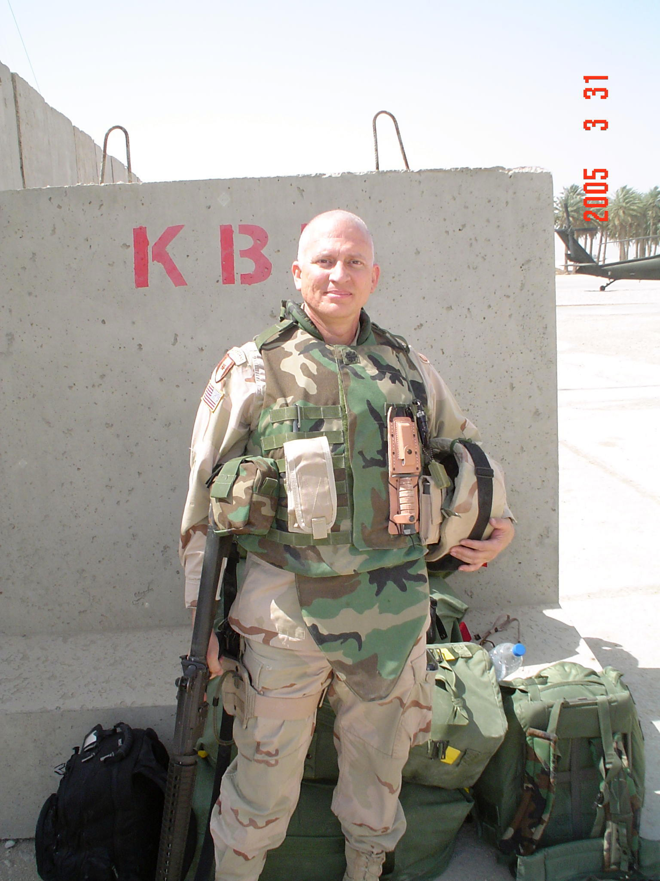
Notes:
This is me…

Slide 5
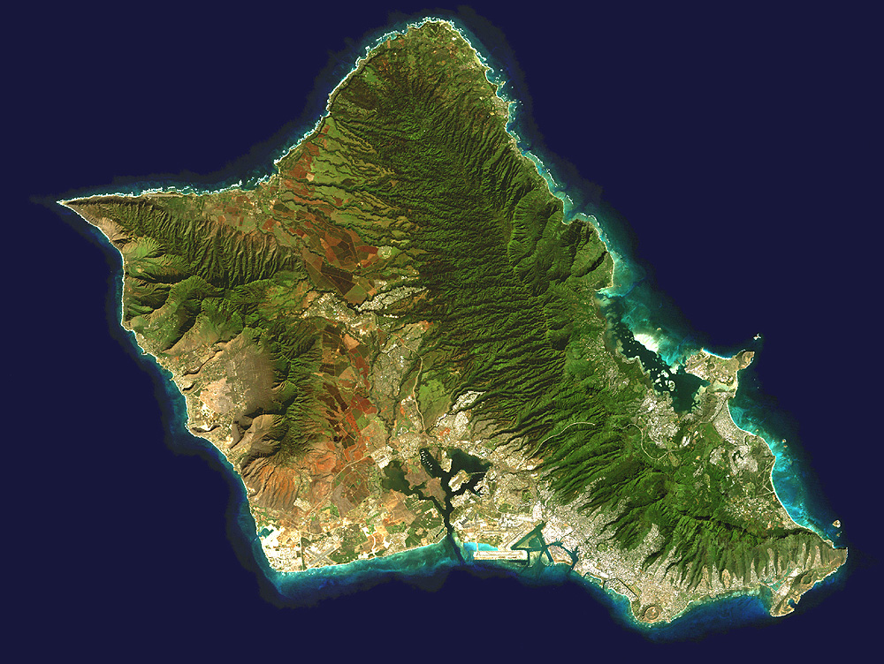
Notes:
This is where I live…

Slide 6

Notes:
This is where I work…

Slide 7
Chemical Addiction
Treatment Services
Mission - Treatment:
Provide substance abuse treatment services to enhance combat readiness, fitness, & effectiveness of total force.
  Army, Navy, Air Force, Marine Corp, & Coast Guard
  Family members
  Retirees
  DoD civilian employees
  Catchment area: Pacific Basin
Notes:
This is what I do…

Slide 8
Chemical Addiction
Treatment Services
Mission - Education:
Train clinicians in comprehensive assessment & care of patients with substance use disorders
  Medical Students
  Resident trainees at Tripler AMC
    Psychiatry Residency Program
    Family Practice Residency Program
  Addiction Psychiatry Fellowship Program
    Tripler Army Medical Center
    University of Hawaii
Notes:
This is what I do…

Slide 9
Addiction Psychiatry
Fellowship Program
DoD’s only GME program for advanced training in Addiction Psychiatry
Located at Tripler Army Medical Center on the island of Oahu in Hawaii
Run in partnership with the University of Hawaii
Intensive 1-year training program
Nationally certified by ACGME & RRC
Notes:
This is what I do…

Slide 10
Objectives
By the end of this briefing, you will…
  Be familiar with diagnostic criteria & assessment guidelines for EtOH use disorders
  Be aware of acute issues in the assessment & care of patients who present with EtOH use disorders
  Be alert to opportunities for interventions with patients who present with EtOH use disorders
  Be able to describe the elements of a comprehensive treatment program for EtOH use disorders

Slide 11
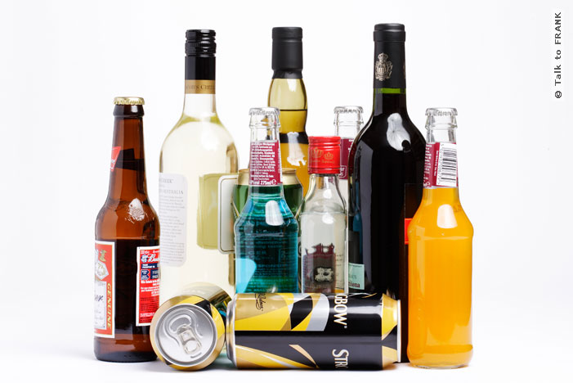
Outline
Epidemiology
Definitions
Pathophysiology
Diagnosis
Management
Pharmacotherapy

Slide 12
Epidemiology
EtOH is the #1 drug of abuse in the U.S.
EtOH use disorders…
  are common, afflicting as many as 15.4 million Americans
  lead to increased mortality & morbidity
    EtOH is the 7th leading cause of disability worldwide
    More years are lost to EtOH than to heart disease
    EtOH-related years lost are 2nd only to cancer
    EtOH is #1 cause of preventable mental retardation
  cost the nation $150 billion/yr in the US (NIAAA estimate)

Slide 13
Epidemiology
Lifestyle & Mortality
“Excessive use of alcohol is the 3rd leading preventable cause of death in the United States.”
  1.06 million deaths/yr
  50% are related to substance misuse
    Tobacco - 419,000
    Alcohol - 100,000
    Illicit Drugs - 20,000

Slide 14
Epidemiology
Morbidity/Complications
Alcohol related:
  Breast Cancer 13%
  Hepatic Cirrhosis 74%
  Fatal automobile accidents 49%
  Falls 17 - 53%
  Fatal deaths due to fire 40 - 64% (BAL’s c/w Intoxication)
  EtOH/Nicotine related Esophageal Cancer 80%

Slide 15
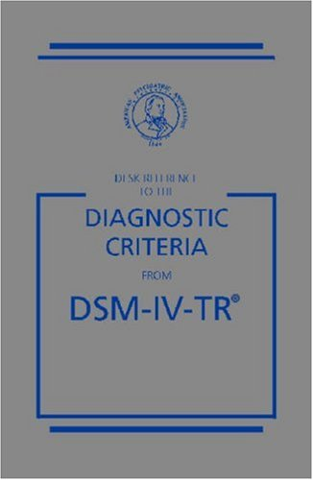
EtOH Use Disorders
Intoxication
Withdrawal
Abuse
Dependence
EtOH-induced Disorders

Slide 16
Continuum of Alcohol Use
Dependent
Binge Use
Abstinence
Moderate Use
Problems / Abusive
Drinking
Notes:
Alcohol is unique in many ways. One of which is the social acceptance of low or moderate levels of consumption. Perhaps even having benefits while taken in moderation. However, there are still up to 30% of adults who do not drink. Conversely about 4 % of adults have defined alcohol dependence with another 4-5% having alcohol abuse which may not be biologically driven.

Slide 17
At-Risk Use
Men: 2+ drinks/day, or
  14 drinks/week or 4+drinks/occasion
Women: 1+ drink/day, or
      7+ drinks/week, or 3+drinks/occasion

Slide 18
Lifetime Prevalence of
EtOH Dependence
Gender
  Men: 15 – 20%
  Women: 1/3rd that of men
Age: The earlier the onset of use, the greater the likelihood of dependence

Slide 19
EtOH Intoxication
Diagnostic Criteria
Recent Ingestion of EtOH
Clinically significant maladaptive behavioral or psychological changes
One or more of the following signs, following EtOH use:
  Slurred speech
  Incoordination
  Unsteady gait
  Nystagmus
  Impairment in attention or memory
  Stupor or coma
Symptoms are not due to a general medical condition or another mental disorder

Slide 20
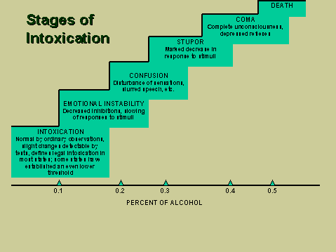

Slide 21
Blood EtOH Levels
BAL = effect on function
  0.1% motor coordination is impaired
  0.2% user is obviously intoxicated
  0.3% physical & mental activity decreases
  0.35% anesthesia is present
  0.4% respiratory drive is critically affected; some die
  0.6% most die

Slide 22
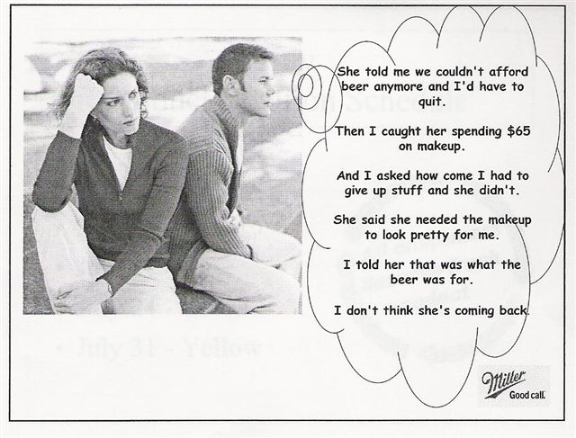

Slide 23
EtOH Withdrawal
Diagnostic Criteria
Cessation of (or reduction in) EtOH use that has been heavy & prolonged
Two (or more) of the following, developing within several hours to a few days later:
  Autonomic hyperactivity (sweating, tachycardia)
  Increased hand tremor
  Insomnia
  Nausea or vomiting
  Transient visual, tactile, or auditory hallucinations
  Psychomotor agitation
  Anxiety
  Grand mal seizures
Symptoms cause clinically significant distress or impairment in social, occupational, or other important areas of functioning

Slide 24
EtOH Abuse
Diagnostic Criteria
Maladaptive pattern of EtOH use, leading to impairment or distress, as manifested by 1+ of the following in 12 month period:
  Recurrent substance use results in failure to fulfill major role obligations (educational, occupational)
  Recurrent substance use in situations in which poses hazard to self or others
  Recurrent substance-related legal problems
  Continued substance use in spite of persistent or recurrent negative social or interpersonal consequences of use

Slide 25
EtOH Dependence
Diagnostic Criteria
Maladaptive pattern of EtOH use that leads to clinically important impairment or distress, as manifested by 3+ of the following in a 12-month period
  Tolerance
  Withdrawal
  More time or larger amounts than desired
  Desire or effort to cut down
  Time spent obtaining or recovering
  Social, occupational, or recreational effects
  Continued drinking in spite of adverse consequences

Slide 26
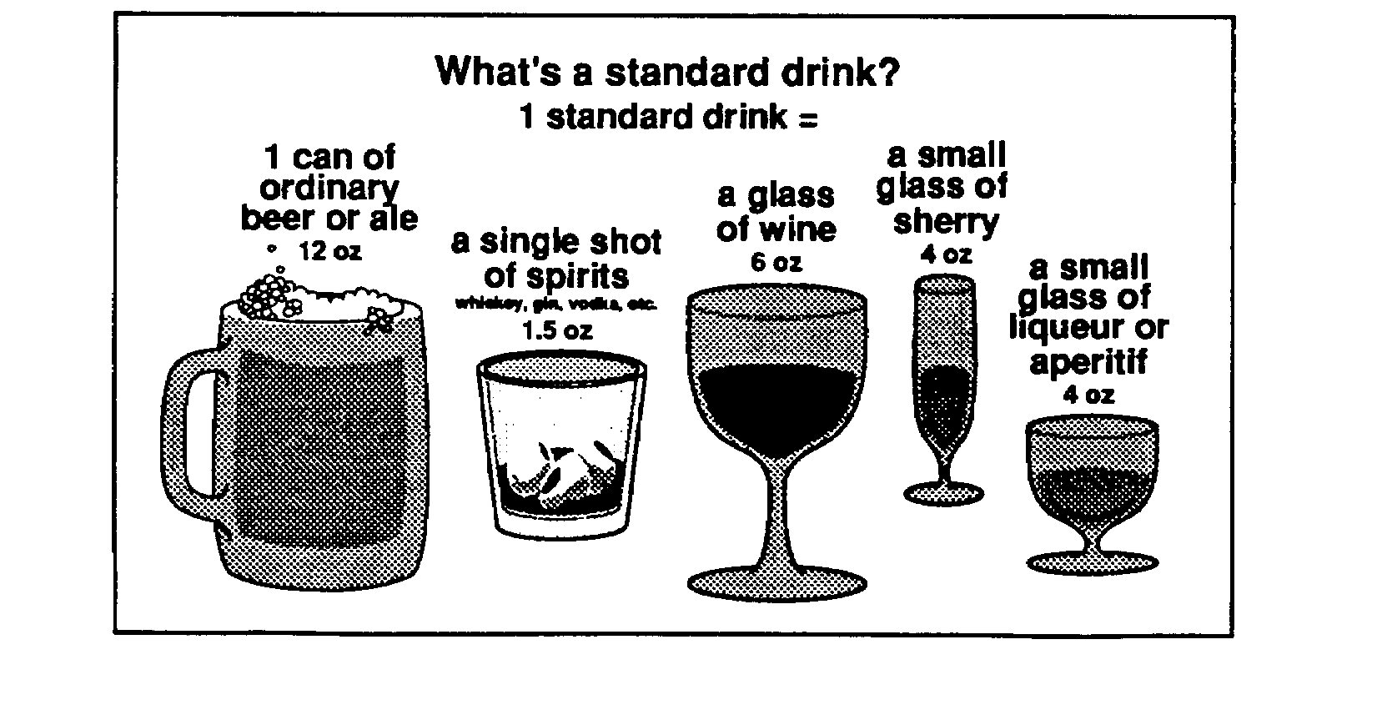
1 Standard Drink = 0.015 ug/dl

Slide 27
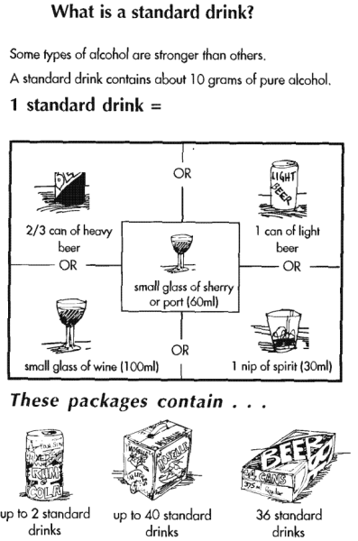
EtOH Content
Drink Concentration
Beer 3 – 7 %
Wine 9 – 20%
Liquor 25 – 75%

Slide 28
Pharmacodynamics of EtOH
Increases the effects of GABA (inhibitory)
Inhibits the effects of Glutamate (excitatory)
Indirectly increases Dopamine levels in mesocorticolimbic system
  mediates positively reinforcing & rewarding effects of EtOH
Indirectly interacts with Opioid receptors, activating opioid system
  reinforces repeat use

Slide 29
Pharmacokinetics of EtOH
Metabolism
  Hepatically metabolized by series of enzymatic steps into CO₂ & H₂0
Excretion
  Elimination primarily through renal system
  Some excretion from lungs & skin

Slide 30
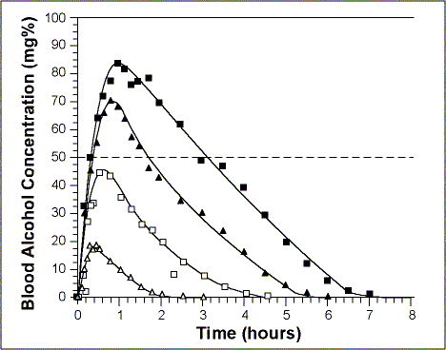
Blood EtOH Levels

Slide 31
Factors Affecting the Rate of
Ethanol Elimination
There is a 3-4 fold variability in the rate of ethanol elimination by humans due to genetic & environmental factors
  Gender Genetic factors
  Age Race
  Food Biological rhythms
  Exercise Alcoholism
  Drugs/medications
Notes:
Factors Modifying the Ethanol Elimination Rate
There is a 3-4 fold variability in the rate of ethanol elimination by humans because of genetic and environmental factors, including sex, age, race, food, biological rhythms, exercise, alcoholism, and drugs.
Sex- Generally, the earlier literature reported no effect of gender on ethanol elimination rates. More recent studies generally indicate a faster role of ethanol elimination by women when rates are corrected for lean body mass. Since women have smaller body size and therefore smaller lean body mass, ethanol elimination per unit lean body mass is higher in women. Men and women generally have similar ethanol elimination rates when results are expressed as g per hr or g per liter liver volume. Because of first pass metabolism by the stomach, it is possible that a given oral dose of ethanol may produce a higher blood ethanol concentration in females than males- see slide on First Pass Metabolism.
Age- Very young animals have low ethanol elimination rates because ADH (and CYP2E1) are not fully developed. Fetal liver eliminates ethanol very poorly which may have consequences for fetal alcohol syndrome. There may be a small decline in ethanol elimination with aging, perhaps due to decreased liver mass, or body water content.
Race- Unclear literature. Ethanol elimination may be higher in subjects containing the β₃ class I ADH isoform compared to the β₁ isoform (see ADH allele slide). Some studies, but not all, suggest an increased rate of ethanol elimination by native Americans compared to Caucasians. Rate of ethanol elimination by Chinese is similar to that of Caucasians. One study reported that African Americans had a lower alcohol elimination rate than Caucasians, which reflected a lower liver weight per unit body weight. Liver mass may explain ethnic and gender differences in alcohol elimination rates. See slide on Acetaldehyde Metabolism concerning active and inactive variants of ALDH.
More research on possible population differences in ethanol elimination is required.
Food- Ethanol metabolism is higher in the fed nutritional state as compared to the fasted state because ADH levels are higher, and the ability of substrate shuttle mechanisms to transport reducing equivalents into the mitochondria is elevated. Food may also increase liver blood flow. Meals high in carbohydrates are more effective than high fat or high protein in increasing ethanol elimination. One explanation for this is the "fructose effect". The sugar fructose increases ethanol metabolism by providing substrates which help to convert NADH to NAD+, and by producing ADP which enhances mitochondrial oxygen uptake. Food also affects absorption of ethanol (slide).
Biological Rhythms- in rodents, the rate of ethanol elimination varies with the time of day, being maximal at the end of the daily dark period. This may be related to a temperature cycle. Few studies have been carried out in humans.
Exercise- unclear literature, most studies report a small increase in ethanol elimination rate, perhaps due to increased temperature or catecholamine release.
Alcoholism- See Metabolic Tolerance Slide. Damaged liver will decrease the rate of ethanol metabolism.
Drugs- Agents which inhibit ADH (pyrazoles, isobutyramide) or compete with ethanol for ADH (methanol, ethylene glycol) or which inhibit the mitochondrial respiratory chain will decrease the ethanol elimination rate. Most hormones do not significantly affect ethanol metabolism; there may be a small increase produced by thyroid hormones.
Jones, et. al., Brit. J. Clin. Pharmacol. 44: 521-526, 1997.
Rogers, et. al., Alcohol Alcohol 22: 345-353, 1987.
Farris and Jones, Alcoholism: Clin. Exp. Res. 2: 77-81, 1978.
Wall, et. al., Alcoholism: Clin. Exp. Res. 20: 1159-1164, 1996.
Bennion and Li, New Engl. J. Med. 294: 9-13, 1976.
Momenthaler, et. al., Alcohol Res.HIth 23: 55-64, 1999.
Kwo, et. al., Gastroent. 115: 1552-1557, 1998.
Green, et. al., Alcoholism: Clin. Exp. Res. 23: 611-616, 1999.

Slide 32
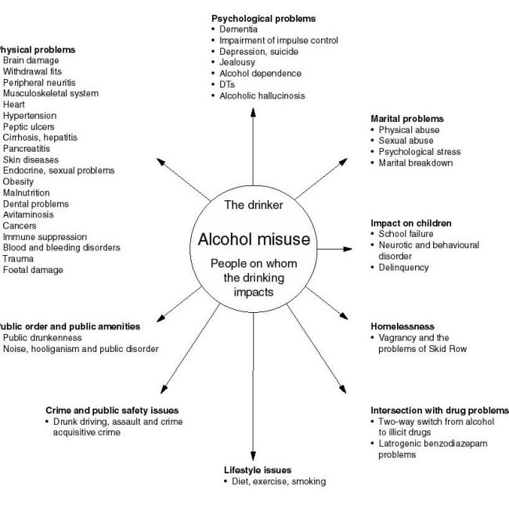
Short-Term Effects

Slide 33
Long-term Effects
Nervous System
  Dementia
  Wernicke’s Encephalopathy
  Korsakoff’s Dementia
  Peripheral neuropathies
Gastrointestinal
  Pancreatitis
  Hepatitis & cirrhosis
  Gastritis & Ulcers
  Esophageal varices
Hematological
  Bone marrow toxicity
  Anemia, Leukopenia, Thrombocytopenia, Pancytopenia
Cardiovascular
  Hypertension
  Cardiomyopathy
Nutritional compromise
  Malnutrition
  B₁₂ deficiency
Metabolic
  Obesity
Oncological
  Cancers of breast, bladder, bowel, mouth, etc.
Reproductive
  Unplanned pregnancy
  Hormonal imbalances
  Reduced fertility
  Fetal EtOH Syndrome

Slide 34
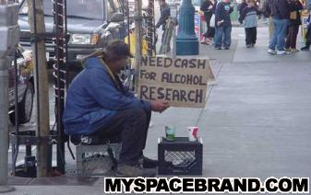
Why do they do what they do when they know what they know?...

Slide 35
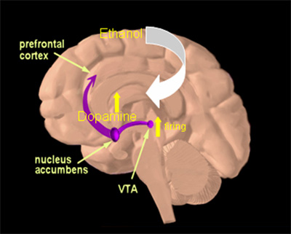
EtOH Dependence is a Brain Disease

Slide 36

Screening for EtOH Use Disorders
Screen all patients for current or recent nicotine and alcohol use at initial visit & at least annually
CAGE*
  2+ requires further assessment
  Sensitivity = 60-95%
  Specificity = 40-95%
Audit
  10 item questionnaire
  Cutoff of 8 out of 40 indicates problem drinking
  Sensitivity = 92 %
  Specificity = 93 %

Slide 37
Referral Sources
Self-referral
Clinical referral
  ER
  Medical ward or clinic
  Psychiatry ward or clinic
Command referral
  Trigger: EtOH-related incident
Court-ordered referral
  DUI, etc.

Slide 38
Assessment of EtOH Use Disorders
Clinical Interview
Mental Status Examination
Physical Examination
Laboratory tests
Imaging studies, if indicated
NOT Neuropsychological testing

Slide 39
Clinical Interview
Presentation
Hx of present illness
Intake: amount, type, time of last drink, etc.?
Hx of complicated withdrawal?
Use of other substances?
Hx of past treatment?
Insight & Motivation
Medical & psychiatric hx (co-morbidity?)
Medications & allergies
Family hx
Developmental hx
Collateral hx
  Record review
  Patient family, friends, commander, police

Slide 40
Clinical Interview
Nutritional Supplements
Ripped Fuel, Enhancer X, Metabolife, Xenadrine, Diet Fuel, etc.
Caffeine & Ephedra
Anabolic steroids

Slide 41
Clinical Interview
Trends in Co-morbidity
  Mood Disorders:
    Major Depression
    Substance-induced Mood Disorders
  Anxiety Disorders:
    Post-traumatic Stress Disorder
    Panic Disorder
  Personality Disorders:
    Borderline
    Antisocial
    Histrionic
  Psychotic Disorders
    Schizophrenia
    Substance-induced Psychotic Disorder

Slide 42
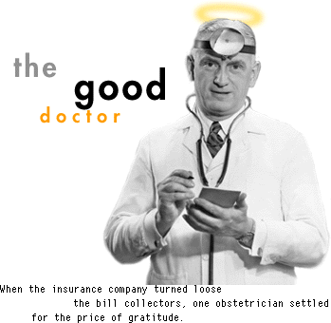
Clinical Interview
M.D.’s Role
Prolong life
Relieve suffering
Optimize functioning
Do no harm
Stay up to date on knowledge, skills, & training in area of expertise
Provide empathic support

Slide 43
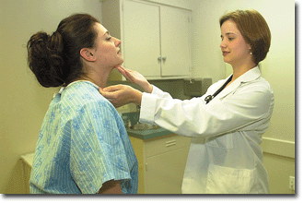
Clinical Interview
Patient’s Role
Acknowledge illness & need for treatment
Seek out medical care appropriately
Communicate clearly & transparently with health care provider
Comply with treatment
Respond to treatment
Thank the M.D. (& pay their medical bills)
Go away

Slide 44

The
Bad Patient
Goals appear to conflict with those of health care provider
May fail to comply, respond, recover, thank, pay, or go away
Invalidates M.D.’s image of caring & competent clinician who makes a difference

Slide 45

Clinical Interview
1ST STEP:
MONITOR YOUR COUNTER-TRANSFERENCE

Slide 46
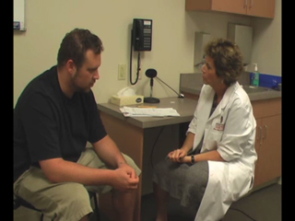
Clinical Interview of Patient
Notes:
Routine clinical encounter is characterized by a patient & a clinician. The patient comes forward on their own initiative, communicates clearly & transparently about their problem, & requests help from the clinician to address it. Patient lays their cards on the table. Encounter is collaborative.

Slide 47
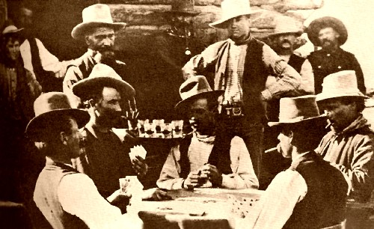
Clinical Interview of Patient with EtOH Use Disorder
Notes:
The clinical encounter with the patient who suffers from a substance use disorder differs from the above encounter. The patient in most cases has not self-referred, is not asking for help, & may not even be aware of a problem. Out of concern of judgment or stigma, the patient does not put his cards down but holds them close to their chest. The encounter is competitive rather than collaborative. Just like a game of poker…

Slide 48
Clinical Interview
Techniques
Develop rapport & be supportive
Withhold judgment
Be direct & firm
Proceed from the gentle assumption
Destigmatize possible pathologies
Overestimate quantities
Progress from general to specific
  Open → Closed Questions
Resort to denial of the specific
Notes:
Here are some interview techniques that have proven effective with this population in order to optimize your chances of getting a full & accurate history.

Slide 49
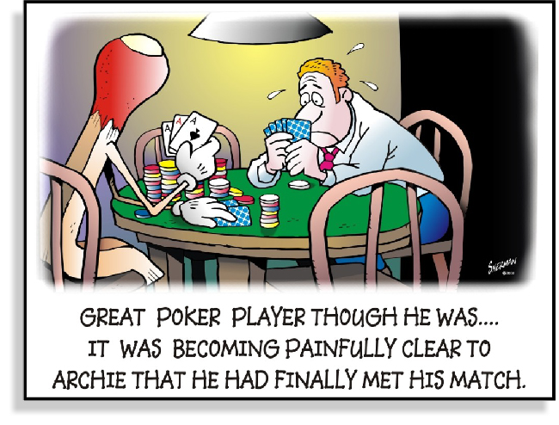
Notes:
With these techniques & some clinical practice, you may become adept at conducting such assessments

Slide 50
Mental Status Examination
Cognitive impairment?
Hallucinations?
Impulsivity?
Suicide/homicide risk?
Insight

Slide 51
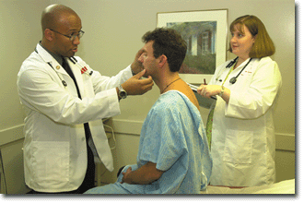
Physical Examination

Slide 52
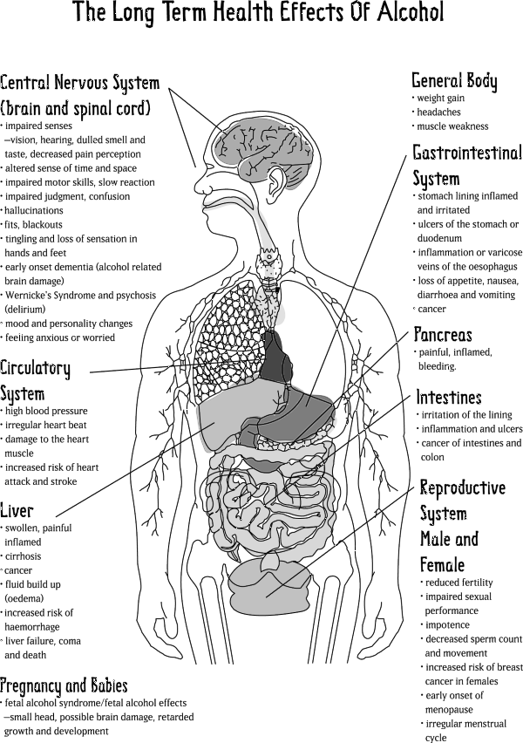
Physical Examination
Vital Signs
Evidence of trauma
Neurological exam
Stigmata of liver disease
Abnormal findings provide window of opportunity for intervention

Slide 53
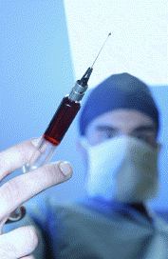
Laboratory Studies
Blood EtOH level
Urine Drug Screen
Urinalysis
Beta-HCG
Blood chemistries
Complete Blood Count
Liver function tests & GGT
PT/PTT
B₁₂ & folate assays
Thyroid function tests

Slide 54
Biomarkers: GGT
Gamma-glutamyltransferase (GGT)
Chronic drinking of 4+ standard drinks/day x 4-8 weeks significantly raises GGT in many individuals
False positives –
  non-alcoholic liver disease
  obesity
  medications (anticonvulsants, hormone supplements, histamine blockers)

Slide 55
Biomarkers: CDT
Carbohydrate-Deficient Transferrin (CDT)
Approved as biomarker by FDA in 2001
Daily consumption of 60+ g of alcohol (about 5 standard drinks) during the previous 2 weeks increases percentage of CDT
Rare false positives –
  End stage liver disease
  Biliary cirrhosis
  Rare genetic transferring variants

Slide 56
Biomarkers
Sensitivity(%) Specificity(%)
GGT 73 75
CDT 69 92
MCV 52 85
AST 50 82
ALT 35 86

Slide 57
Biomarkers
30% decrease in GGT &/or CDT indicates abstinence or significant reduction in EtOH consumption
30 % increase in GGT or CDT may indicate relapse

Slide 58

Phases of Treatment
Clinical Assessment
Management of Acute Withdrawal
Rehabilitation

Slide 59

Treatment Priorities
Manage complicated withdrawal sx
Prevent &/or manage medical complications & co-morbidities
Address suicide & homicide risk

Slide 60
Rehabilitation
Multi-disciplinary care
  MDs: Medicine, Psychiatry
  PhDs: Psychology
  MSWs: Social Work & Family Counseling
  SACs: Substance Abuse Counselors
  Peer counselors & sponsors
Multi-modal care
  Individual & Group Psychotherapy
  Couples & Family Therapy
  Psycho-education
  12-Step Group Involvement
  Recreation Therapy

Slide 61
Rehabilitation (ASAM)
Level I: Outpatient Services
Level II: Intensive Outpatient or Partial Hospitalization
Level III: Residential or Inpatient Services
Level IV: Medically Managed Intensive Inpatient Services

Slide 62
Interface of Resources
Level IV
Inpatient with medical support
Level III
Inpatient/residential
Level II: TRISARF
day hospital
Level I
outpatient
Referral
Aftercare

Slide 63
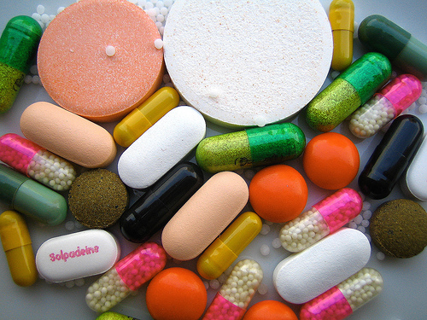
Pharmacotherapies
(see Russ Hicks for details)
Available
  Disulfiram (Antabuse)
  Naltrexone (Revia)
  Acamprosate (Campral)
Under investigation
  Topiramate (Topamax)
  Ondansetron
  Varenicline (Chantix)

Slide 64
Caveats About Rehabilitation
Addiction treatment is not one size fits all. There are many options - use them
Compliance with treatment is essential. Continually support treatment
Treatment is not a “carve out” available only in select settings
While abstinence is often the goal, it is not the only goal

Slide 65
Summary
EtOH Use Disorders are a READINESS issue: they account for HUGE amounts of morbidity & mortality in both society & the military
EtOH Dependence—indeed, any chemical addiction—is a BRAIN DISEASE that requires application of the CHRONIC DISEASE MODEL
Although treating EtOH Use Disorders is not our only mission, it is our BIGGEST mission

Slide 66
Summary
Remember to monitor your own counter-transference & be professional at all times (& help your less enlightened colleagues do the same)
Successful treatment is MULTI-DISCIPLINARY & MULTI-MODAL
Dual diagnosis may be the RULE, not the exception

Slide 67
Resources/Regulations
AR 600-85
VA/DOD Substance Abuse CPGs
NIAAA
NIDA

Slide 68
?

Slide 69
Contact Information
John J. Stasinos, M.D.
LTC(P), MC, USA
Chief, Chemical Addictions Treatment Services, TAMC
Director, Addiction Psychiatry Fellowship Program
(808) 433-6566
john.j.stasinos@us.army.mil

